Slide 1


Theory +Economic Survey Vol.2 + Vol.1 + Budget 2016
1.Banking Finance
6.HRD
2.Budget-Fiscal Policy
3.BoP
4.Sectors of Economy
5.Infra
V2C2-Pub.Fin; V1C3-JAM
V2C3-Monetary mgmt+FI
V2C4-External sector
V2C5-Price,Agri.; V2C6,7
V2C8-Paris Summit, Energy
V2C9-Social infra.
V1C4-Agri ; V1C9-Fertilizer
V1C5-mother-child
V1C6-bounties; V1C7-Fiscal Cap
V1C8-PTA
V1C2-Chakravy; V1C10-Labour
V1C11-Powering 1 India
B1. Financial Sector Reforms
B2. Fiscal Discipline
B3. Tax Reforms; B4. Ease of
B5. Agro: 2x farmer income
B6. Rural infra-employment
B7. Infrastructure
B8. Social Sector & healthcare
B9. Education, Skills, Jobs
V2C1- Chakravyuh challenge
V1C1- Twin Balancesheet
+Survey Ch.1s Spread throughout; SDG-Goal esp. @#4,5,6; HDI Report@6

Slide 2
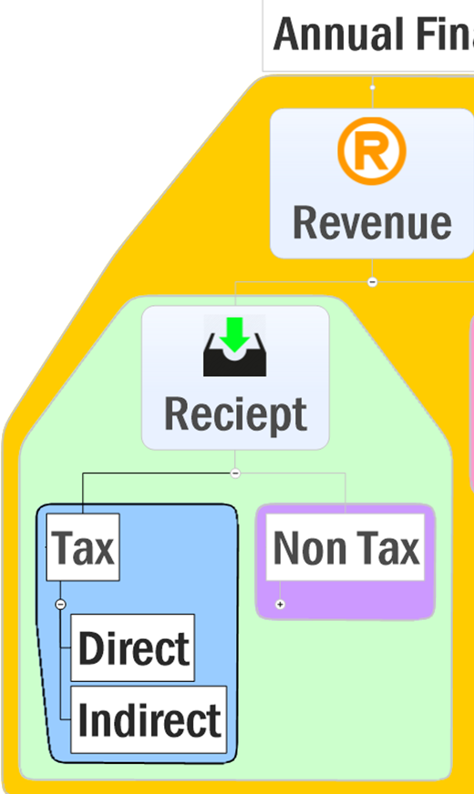
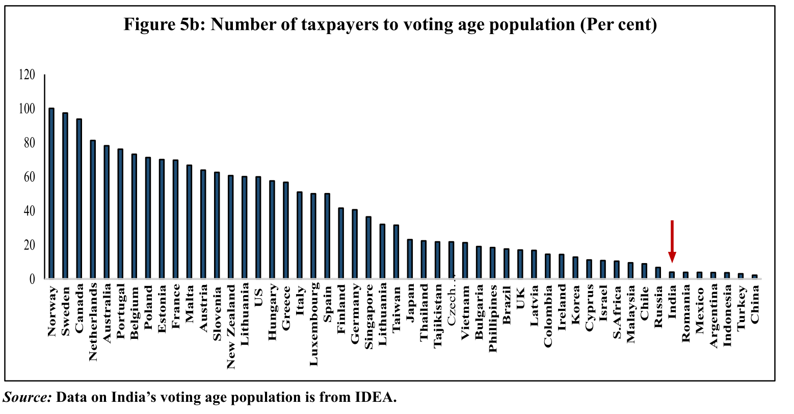

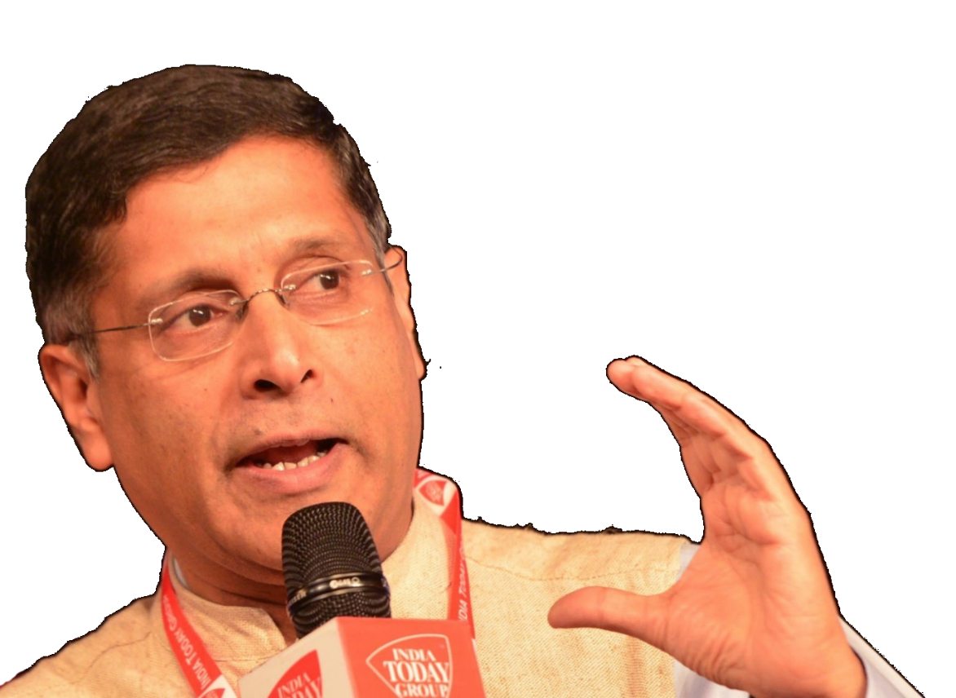
Survey Vol.1 Chap.7: Fiscal capacity
Ceiling
Leakage
Property Tax

Slide 3
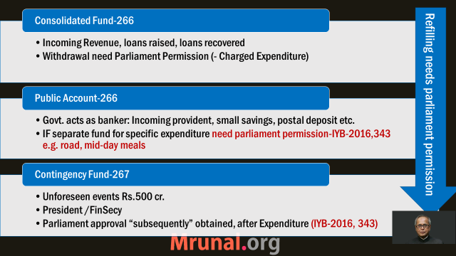
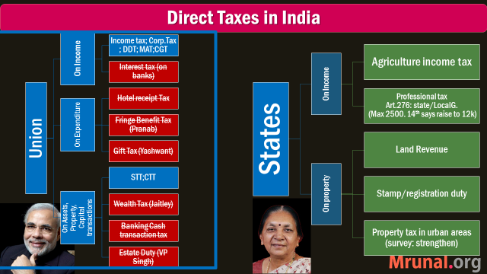
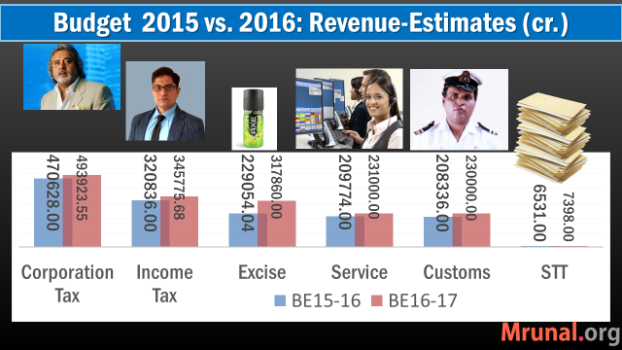
Recap: Budget ► Revenue ► Taxation

Slide 4

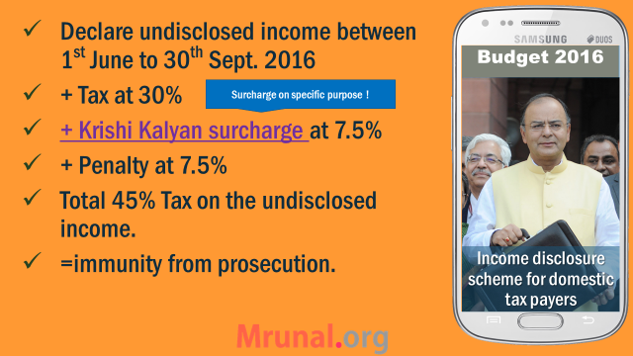


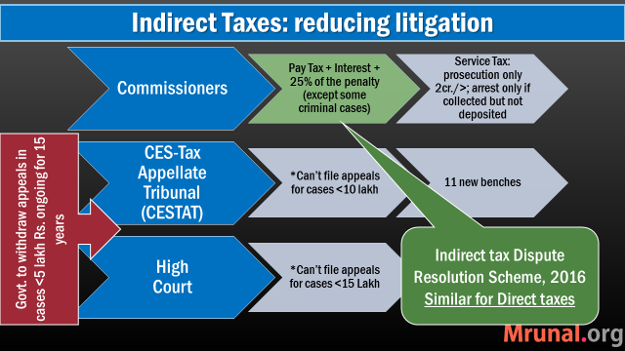
Budget ► Revenue ► Taxation: avoidance, evasion, litigation,

Slide 5

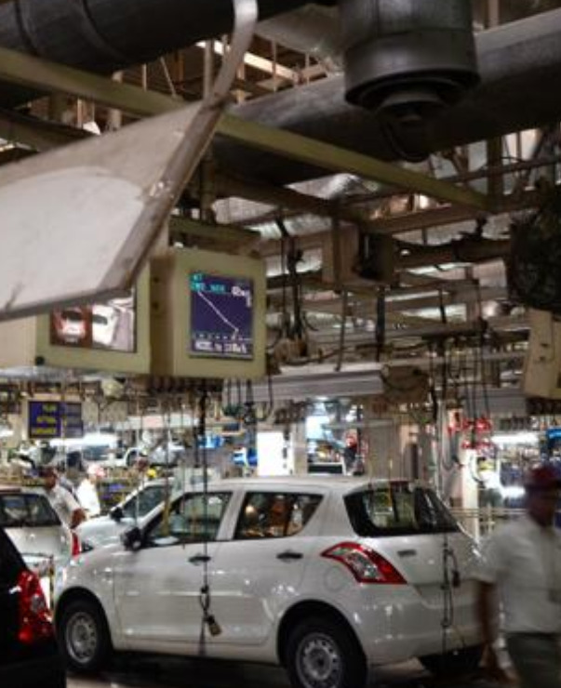
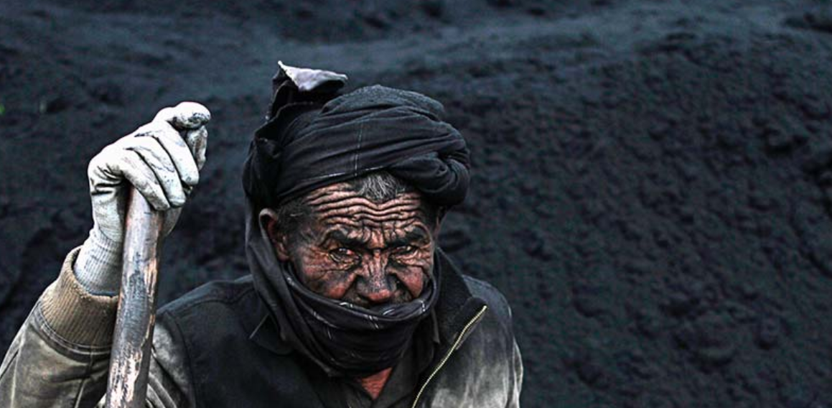
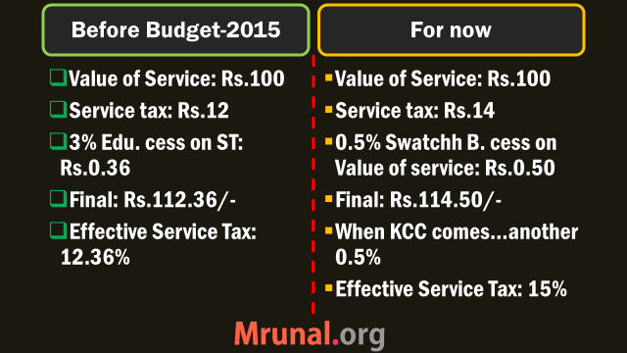
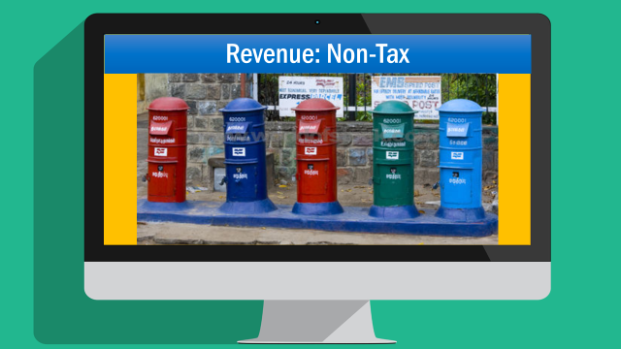
Budget ► Revenue ► Indirect Taxes

Slide 6


Recap of last lecture

Slide 7
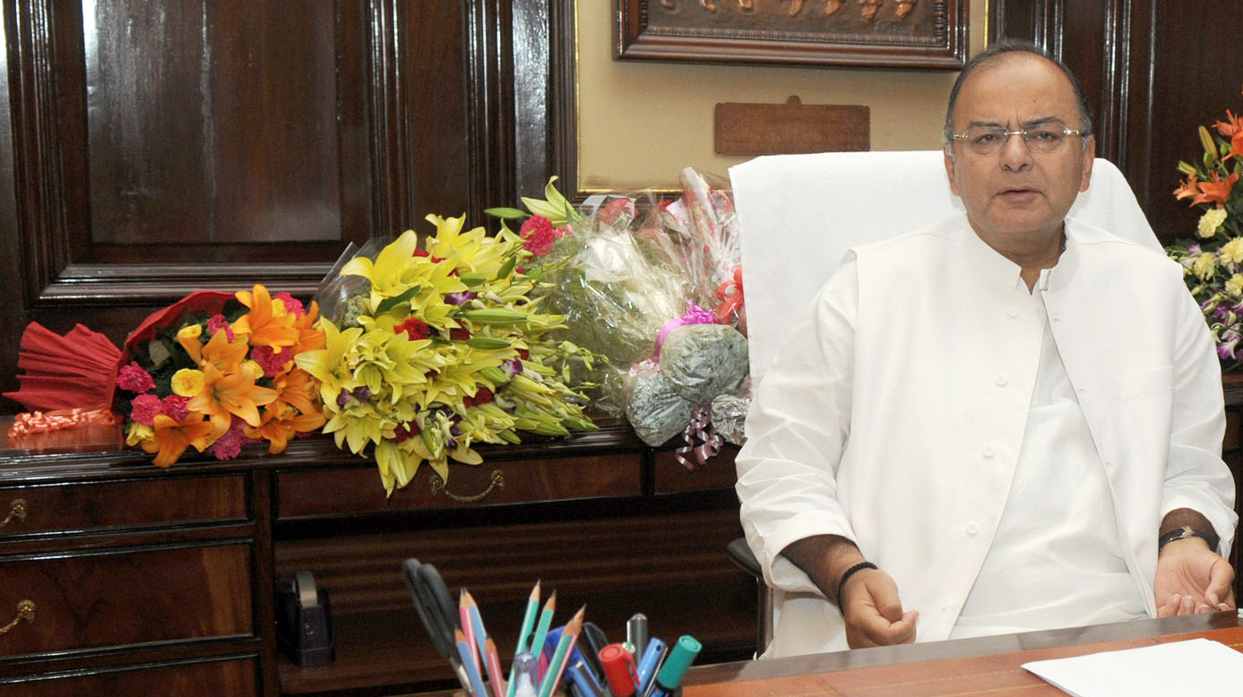

Pillar #2: Budget / Fiscal Policy
Fiscal Capacity
Taxation
Subsidies- can’t jam everything
Disinvestment
CSS Restr.
7th PC
GST, 14th FC
Self study

Slide 8
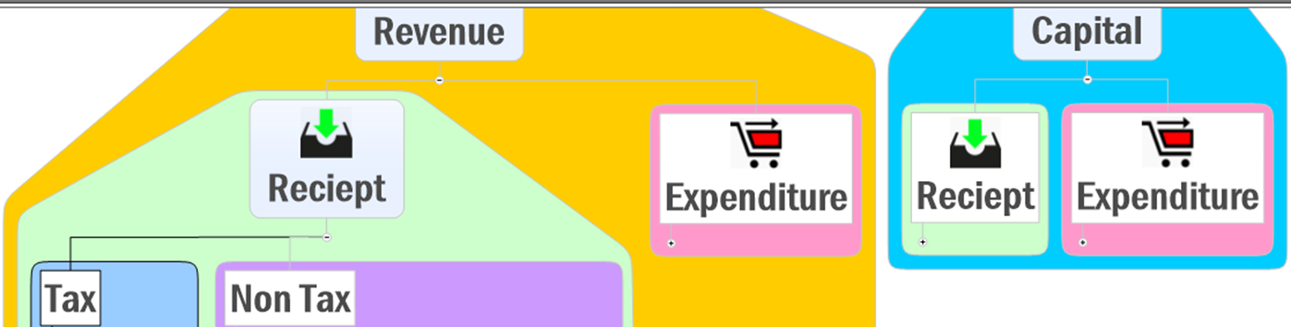

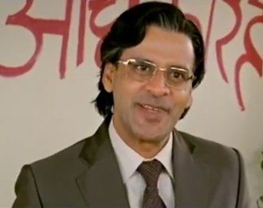
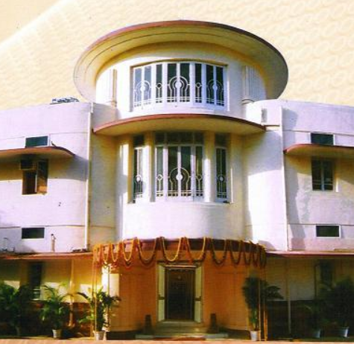
Budget ►Revenue ► Expenditure
General Services
UPSC+SSC:
384 cr.
General Services
UPSC+SSC:
168cr.
“Loss”: 217 cr.
Not for me, it isn’t !!

Slide 9


Budget ►Revenue ► Expenditure
Components
General Services
Social Services
Economic Services (+Rail budget Exdr. Part)
Grants to States/Foreign Countries
Revenue Expenditure of UT without Legislature

Slide 10
Parts of Expenditure
NON-Plan Expenditure |  | PLAN Expdr
Revenue Expenditure | Capital Expenditure

Slide 11
Parts of Expenditure
NON-Plan Expenditure |  | PLAN Expdr
Revenue Expenditure | Capital Expenditure
Salaries and pensions Interest paid (on whatever loan Union had taken) Subsidies, Debt relief to farmers. Losses in Postal dept services: health, edu, broadcasting etc. Grants given to States/UT/Foreign nations. | Defense capital Expenditure (e.g. buying machines, vehicles etc.) Capital Expenditure on railway, postal, various ministries Loans to PSUs/States/UT/Foreign nations. | Money spent on Five year plans (of Union) Money given to state/UT for their Five year plans
This plan-non plan distinction will be removed from Budget 2017

Slide 12
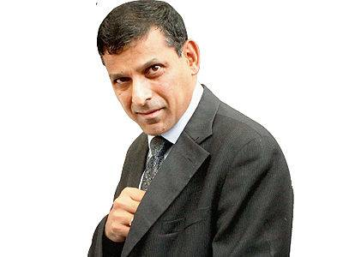
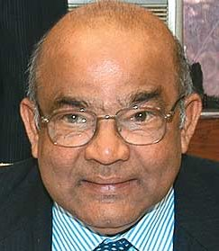
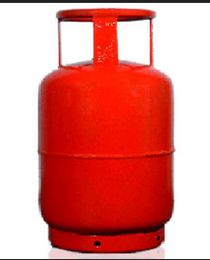
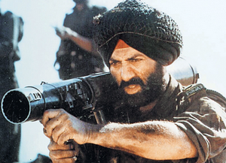
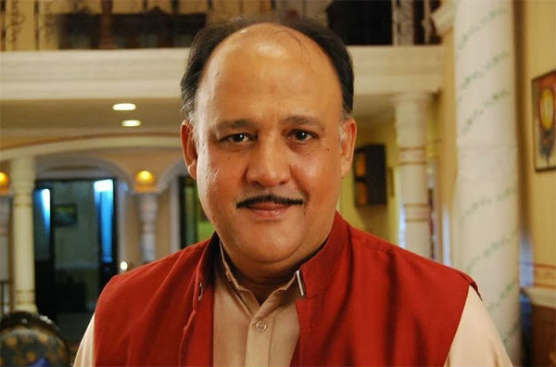
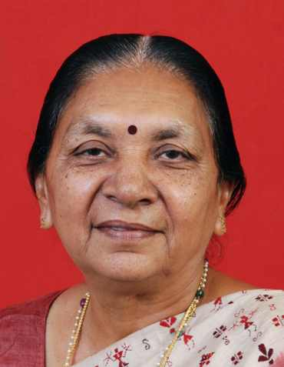

2016-17: Non-plan Expenditure (Cr.)
▼= compared to RE-2015
Non plan grants given as per
14th FC (YV Reddy)
Revenue Deficit Grant
State disaster Management
Local Bodies Grant
Interest
5L
Decreasing order
Subsidies
2.5L (▼)
Defense
2.49L
Both Revenue + Capital
Revenue Expenditure: Salaries, stores, logistics
Pension
1.2L
Grants
1.15L
Includes both Civil and defense pensioners. ▲ because OROP & 7TH PC
Police 60k

Slide 13
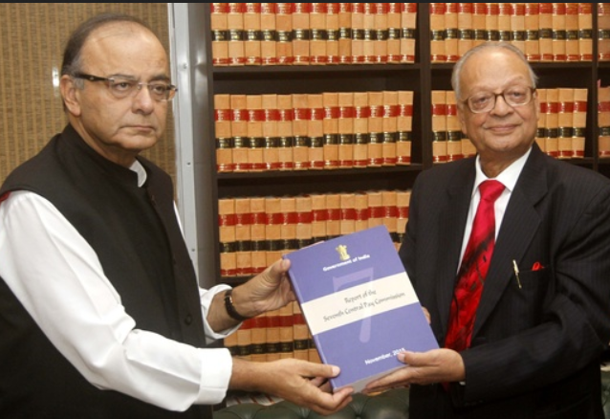
7th Pay Commission (2014-16)
Justice Shri Ashok Kumar Mathur
Chairman
Shri Vivek Rae (Petro.Min)
Member
Dr. Rathin Roy (NIPFP)
Member
Smt. Meena Agarwal
Secretary
1st PC Srinivasa Varadachariar
1946-47
6th PC
Justi. B.N.Srikrishna
2006
7th PC
Justi. A.K.Mathur
2014-16

Slide 14
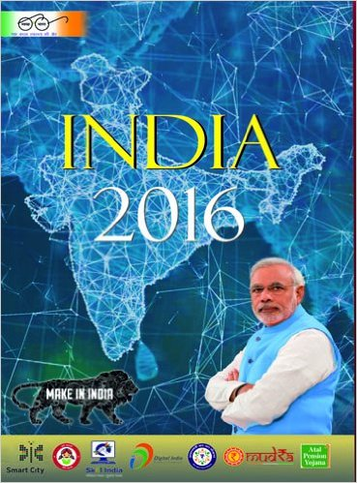
Who implements Pay commission Report?
fin.min
Economic Affairs
Expenditure
Revenue
Financial services
Disinvestment Investment & Public Asset Management
Budget►
Survey►CSO,CEA,Finsec,FM
ICAS via UPSC-CSE
7th PAY commission WEF 1/1/16
CBDT, CBEC- both statutory bodies
RRB, PSB, AIFI, IRDA-PFRDA
Renamed in Budget 2016

Slide 15
Yearbook-2016
Which of the following is not an “Apex/Independent Office” in union Government?
PMO
Cabinet Secretariat
Department of Space
Niti Ayog
Independent “dept”; others are “offices”. Page 50/IYB-16

Slide 16
7th Pay Commission Report – Justice A.K.Mathur
Min.Max
Civil services
Inflation?
Defense
Kaam-chor
Misc.

Slide 17



7th PC WEF 1st Jan 2016; ~24% hike than earlier
Max. Pay Rs.2.25 Lakh But Cabinet Secretary 2.5 lakh
Min. Pay Rs.18,000 per month (Dr.Aykroyd formula, worked in FAO-UN before independence)
Annual increment 3%
Overall fiscal burden
Rs.1.02 lakh or 0.65% of GDP

Slide 18
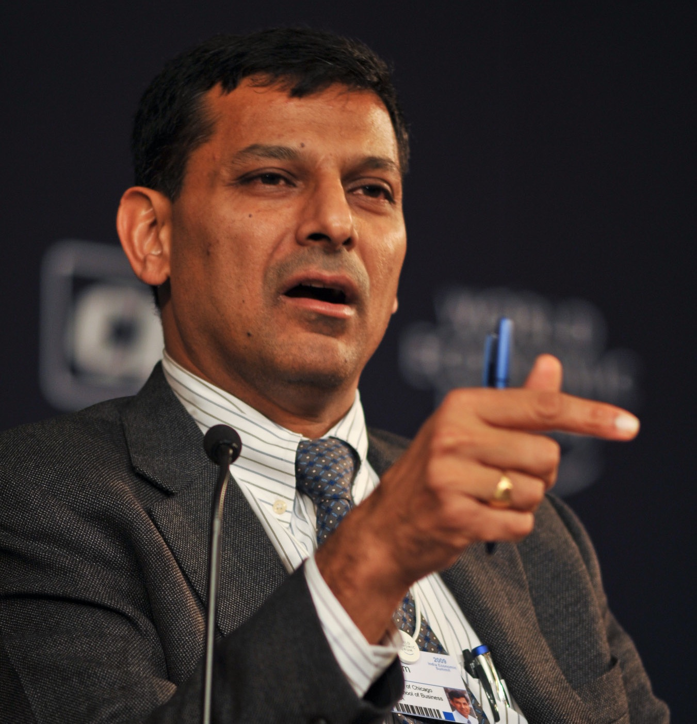
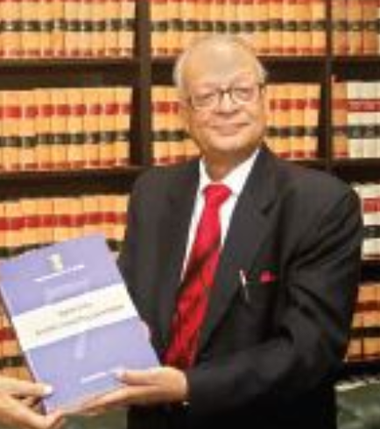
7th PC: regulatory bodies
Rs.1.98 lakh
salary I get per month
For select regulatory bodies
Chairman: 4.5 lakh; Member: 4 lakh
Rs.65,000 crores
Dividend I pay to Govt. per year
Sorry bhai, ye aapke liye nhi hai

Slide 19
Beneficiaries
7th PC
Statutory regulatory bodies- excluding RBI
Union Govt. employees: industrial, non-industrial
All India Services
Personnel in UT, SC, Audit-Accounts
Pensioners (52 lakh)
Notes:
Members of statutory bodies?

Slide 20

7th PC will bring inflation or not?
Otherwise my workload will increase under M.Policy framework
2-6% CPI All India
Nahi bhai aisaa nhi hogaa ☺

Slide 21
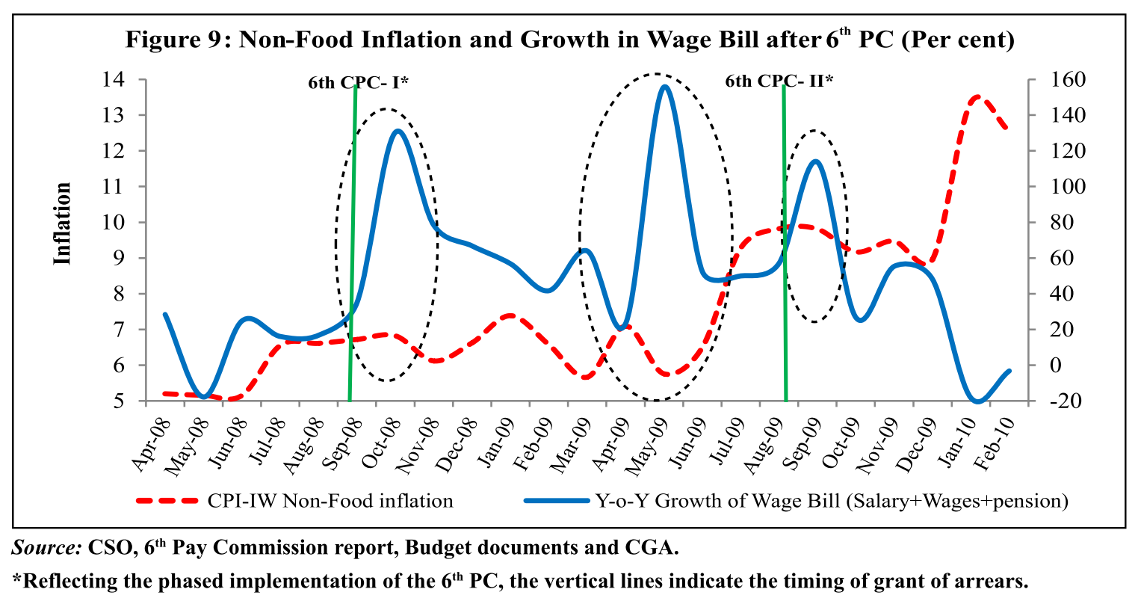
Pay commission and inflation

Slide 22

House rent allowance (% of basic pay)
HRA : depending on city
16%
24%
8%
House Building Advance
7.5 lakh
25 lakh
HRA: CPI 0.3% rise
Notes:
Because wholesale not count.

Slide 23
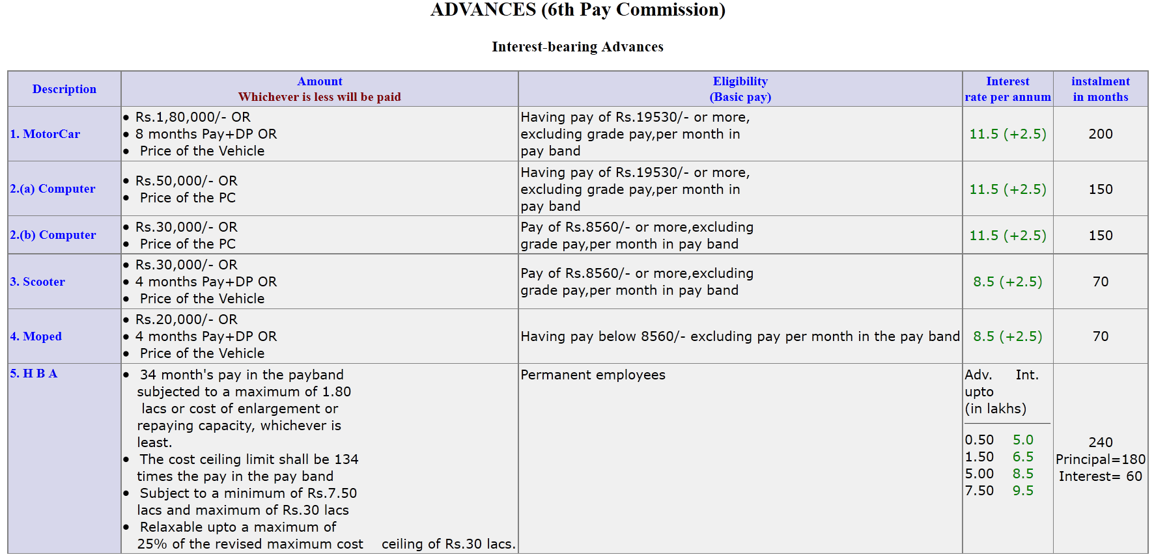

7th PC on Interest bearing advance
Max. 25 lakh
Can borrow from banks

Slide 24
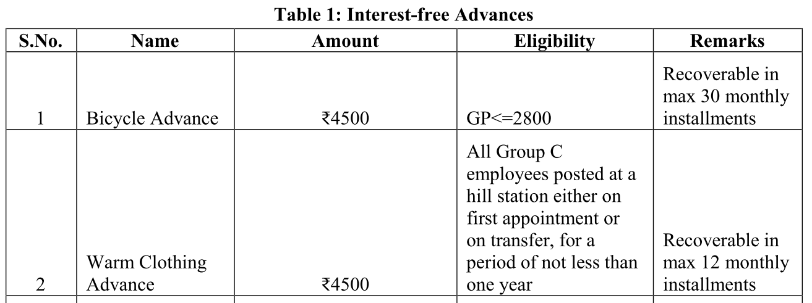
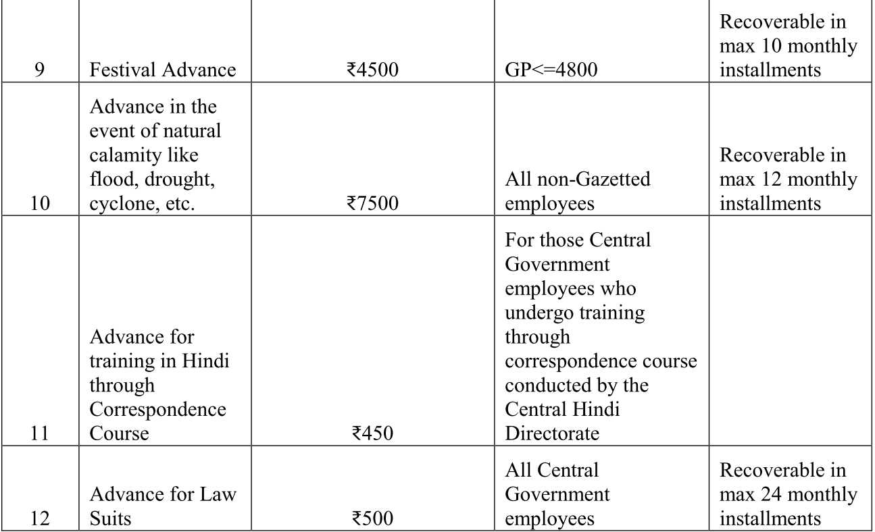
7th PC on Interest-free advance: abolish them
Salary packages greatly increased in recent years. These outdated allowance have meagre amt, high Administrative cost
So, abolish them

Slide 25
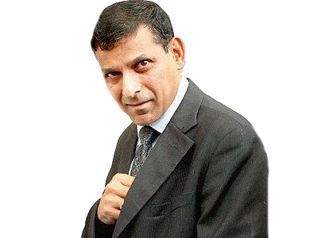



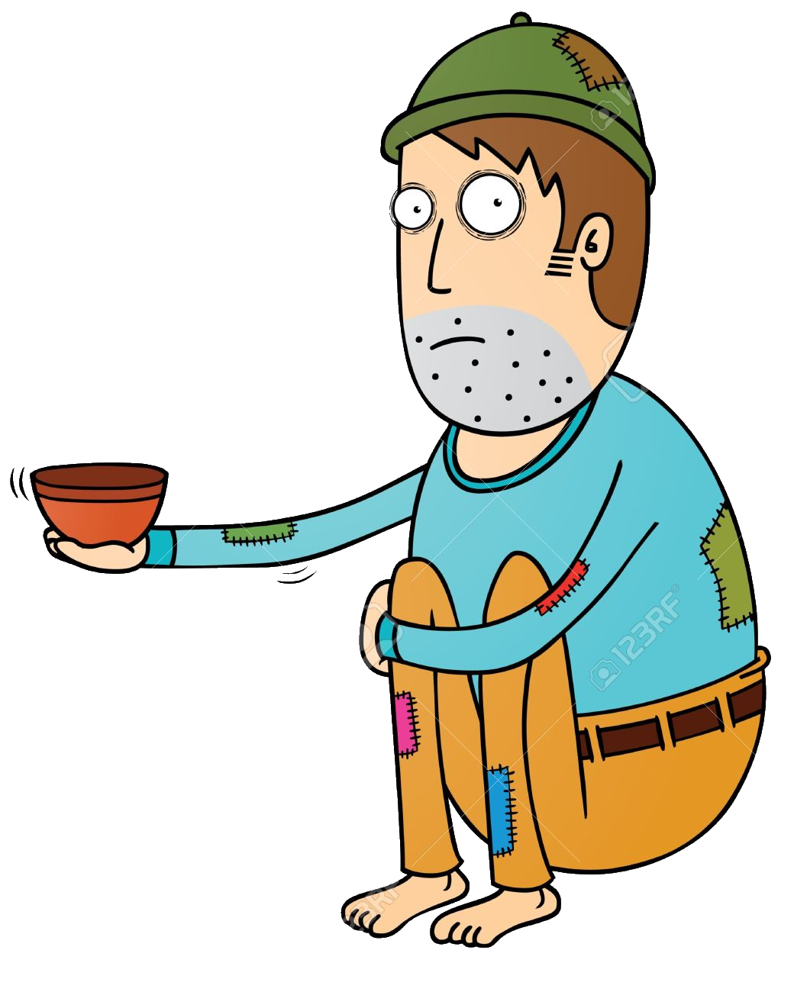
Demand Pull inflation
Onion
Rs.100/kg Rs.2000/kg
DDSLLY

Slide 26
Demand Pull inflation by Public Expenditure
La-Nina
Make in India, EoDB, Startup
Aggregate (Govt) Demand
Pay commission
Fiscal deficit
Aggregate Supply
Minor role

Slide 27
Inflation & LIQUIDITY Angle
7th PC
~24% hike yes, BUT
Tax saving financial products
Officers: - Bank capitalization bonds
“Interest bearing advances” gone- except house, computer
“interest free advances”= all abolished
52 types of allowances.
Abolish overtime pay
Employee group insurance premium ▲
Notes:
Members of statutory bodies?

Slide 28
Minor impact on inflation because…
7th PC
HRA: CPI 0.3% ▲
IF Spilled into private wages- but slack in market
Even if spilled in private sector- firms running under-utilized- so won’t pass costs to customers
Notes:
Members of statutory bodies?

Slide 29
Pay commission and inflation

Slide 30
7th Pay Commission Report – Justice A.K.Mathur
Min.Max: 18k, 2.5 lac
Civil services
Inflation?- minor
Defense
Kaam-chor
Misc.

Slide 31
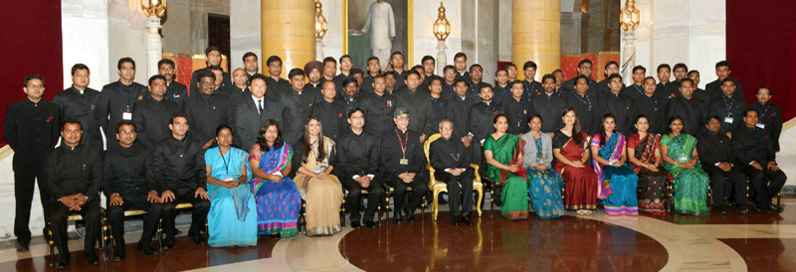
“Edge” enjoyed by IAS
2 years faster promotion than others
Addl. 3% Increment during promotion (IFS-Foreign too)
17 years of service, treat all AIS, Central Group “A” equally for empanelment for central posts
Give this to IPS, IFS (Forest) too- they too risk injury, death and hardship.

Slide 32
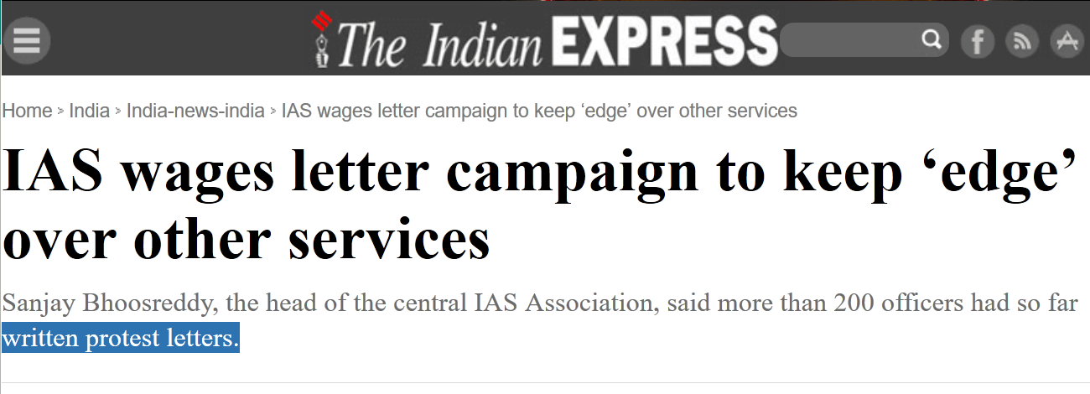
Civil services differing views
7th PC
One Member: remove “edge” altogether, otherwise if IAS so “superior”, recruit them separately.
GS4 Ethics: “IAS should not campaign openly in print/social media”

Slide 33
7th Pay Commission Report – Justice A.K.Mathur
Min.Max: 18k, 2.5 lac
Civil services- Edge
Inflation?- minor
Defense
Kaam-chor
Misc.

Slide 34

Uniformed services
7th PC
SSC officers can exit between 7th to 10 years of service.
Lateral entry of defense personnel into CAPF.
“Martyr status” for CAPF personnel
Risk-hardship allowance ▲ esp. for Siachen.
~2x ▲ in defense salaries.
OROP- for civilian employees as well.

Slide 35
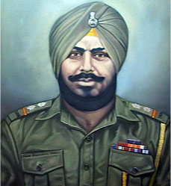
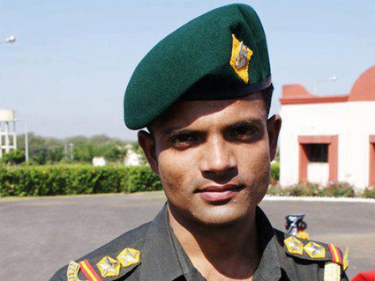
Defense pension based on Last drawn salary
WEF 2006, new formula: Pension = **% of Last drawn salary
30,000
50,000
Same rank but different pension.
Images, formula, figures for illustration purpose only
Notes:
Pension depend on last salary drawn; Problem: Those retired before 2006 get less $$ vs after 2006- even if in same rank. (UPA norms)
Ex-servicemen demanded "one rank one pension" (irrespective of retirement year.)

Slide 36
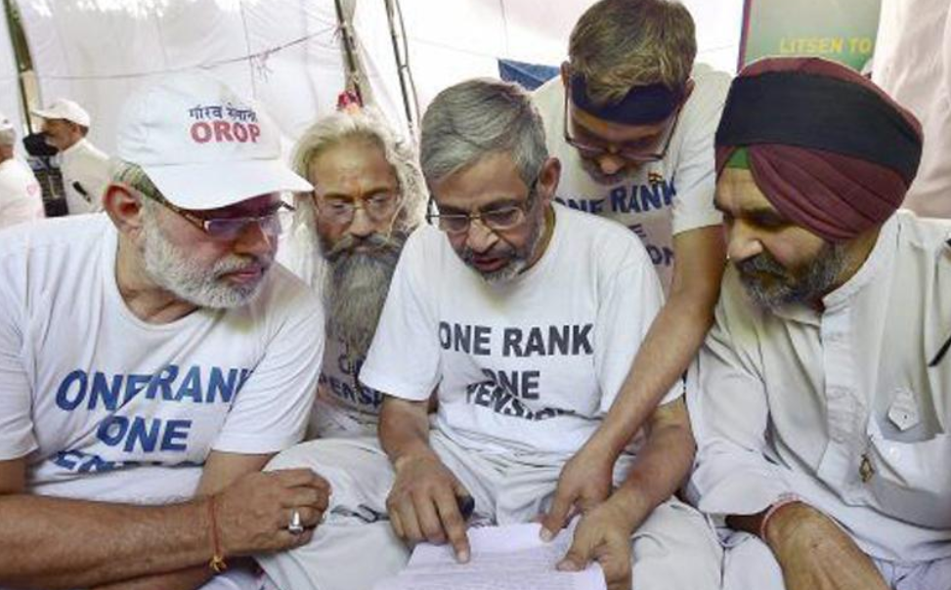
OROP
2015-Nov: Modi agreed. But section of ex-serviceman still dissatisfied with formula.
>~8,000 cr per year for 25 lakh ex-servicemen.
7th PC
Unlike civilian employees
85% soldiers retire ~35 age
can be discharged for disability

Slide 37
7th Pay Commission Report – Justice A.K.Mathur
Min.Max: 18k, 2.5 lac
Civil services- Edge
Inflation?- minor
Defense: Lateral entry, Martyr, OROP, 2x
Kaam-chor
Misc.

Slide 38

Kaam-Choro ke liye kya?
7th PC
Withholding Annual Increments of Non-performers
Remove Bonus scheme, introduce performance related pay scheme.
Pay matrix instead of grade pay.
Stringent Modified Assured Career Progression (MACP)

Slide 39
Misc.
7th PC
Don’t appoint PC /10 years.
Mechanism for annual increment based on CPI and other factors.
Simplify allowance-claim process
Tweak NPS system

Slide 40
7th Pay Commission Report – Justice A.K.Mathur
Min.Max: 18k, 2.5 lac
Civil services- Edge
Inflation?- minor
Defense: Lateral entry, Martyr, OROP, 2x
Kaam-chor: withhold increment, pay matrix, MACP
Misc.: don’t appoint PC

Slide 41
Pillar #2: Budget / Fiscal Policy
Fiscal Capacity
Taxation
Subsidies- can’t jam everything
Disinvestment
CSS Restr.
7th PC

Slide 42

TODAY: Budget ►Revenue Part
NEXT
1 Lakh Cr. Subsidies going to rich, but We can’t JAM-DBT everything because….?

Slide 43
2016-17: Non-plan Expenditure (Cr.)
▼= compared to RE-2015
Non plan grants given as per
14th FC (YV Reddy)
Revenue Deficit Grant
State disaster Management
Local Bodies Grant
Interest
5L
Decreasing order
Subsidies
2.5L (▼)
Defense
2.49L
Both Revenue + Capital
Revenue Expenditure: Salaries, stores, logistics
Pension
1.2L
Grants
1.15L
Includes both Civil and defense pensioners. ▲ because OROP & 7TH PC
Police 60k

Slide 44
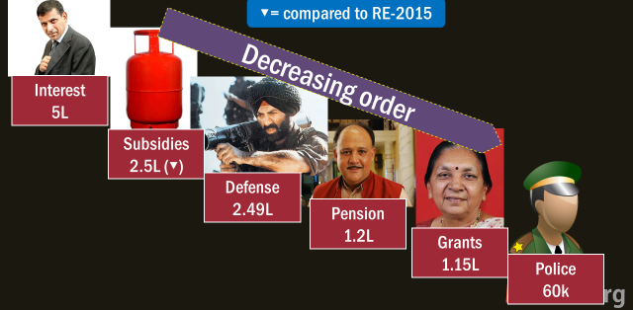
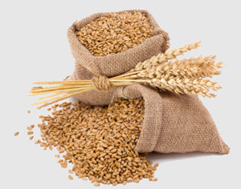

Decreasing Order
1.3L (▼)
70k (▼)
Urea>>NBS (P,K)
100% neem coating, commercial diversion …x
27k (▼)
LPG>> Kerosene

Slide 45
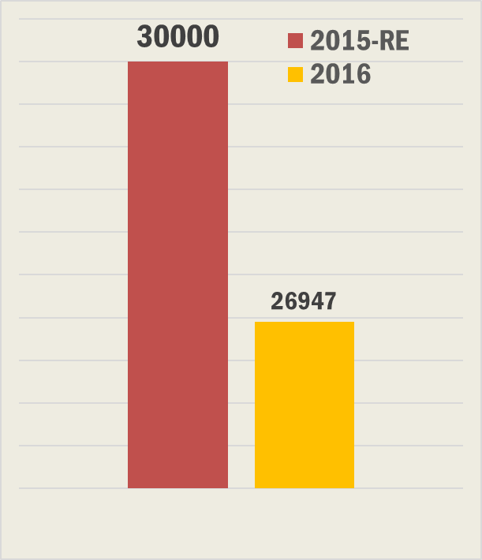
Petroleum subsidy how ▼
Petrol Diesel already deregulated.
1st Jan 2015: Pahal DBT- both Adhar & Non-Aadhar ► Leakage▼.
Budget-2016: No LPG-DBT if husband/wife had >Rs.10 Lakh taxable income in previous FY.
States also started Kerosene-DBT –cash incentive for subsidy savings- 75% for first two years

Slide 46
Government target: Subsidy as % of GDP
GSM3: Resources Mobilization
Food,Fuel,Fert: 2.3Lcr.
Overall: 2.5 Lcr

Slide 47
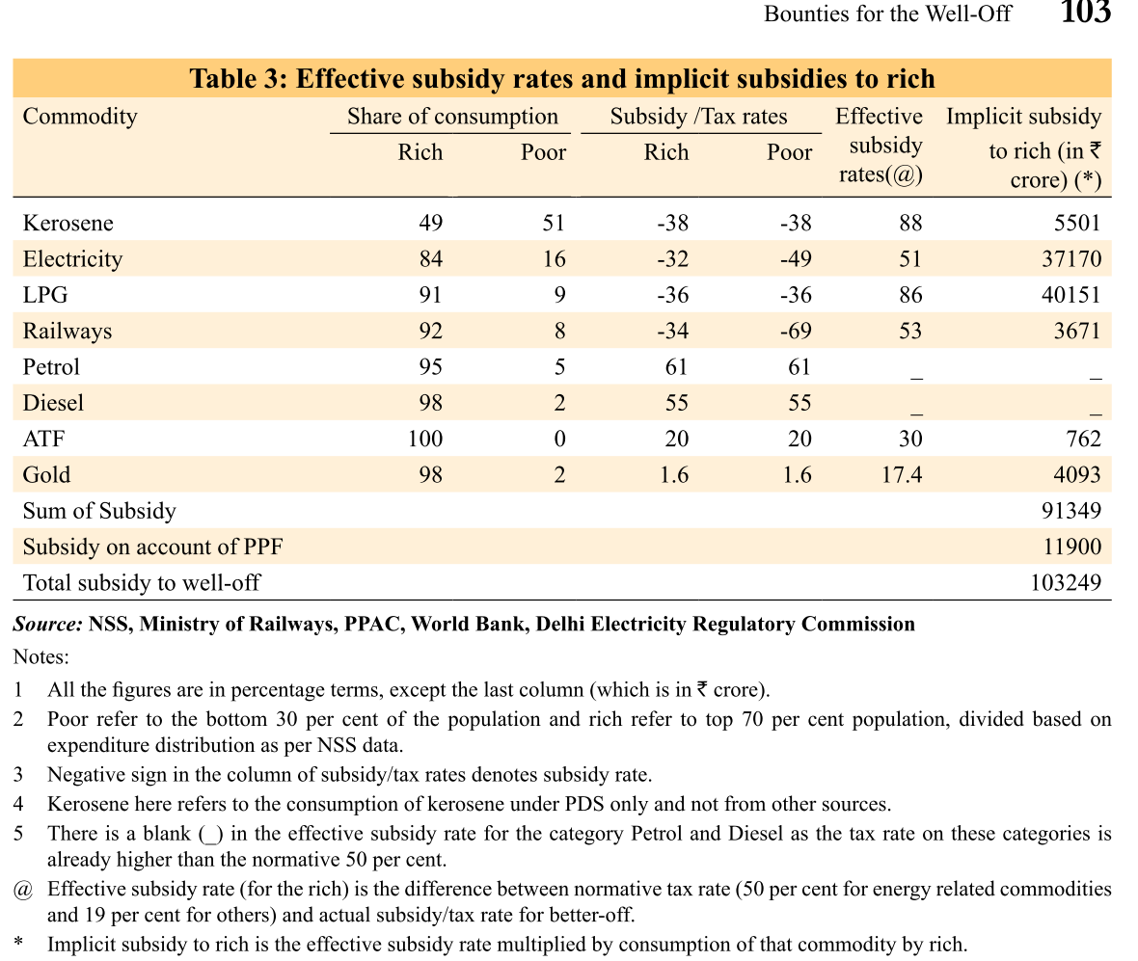
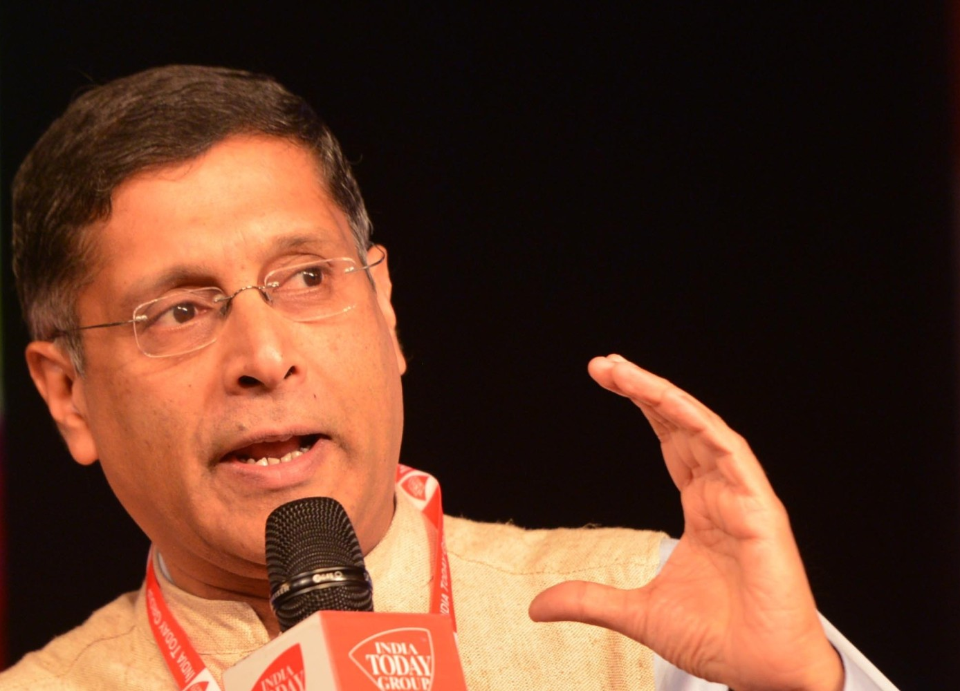

V1c6: >1 lakh cr. Going to well-off section of the society
We’ve to stop the bounties to the well-off….
But can’t “JAM” everything

Slide 48

Science of LPG- Liquefied Petroleum Gas
How to produce?
Refine crude oil OR
Apart from Cooking
Fractionation of Natural gas
Characteristics
Main components: Butane, Propane
Color, odour= x ; Ethyle Mercaptan as odouriser to detect leak
Heavy than air
Metal cutting; generators
Kiln, furnace, incinerator, crematorium
Fabrication; fibre-glass; Propellant in aerosol

Slide 49
LPG Pahal scheme
Buy @market rate (670)
DBT: Rs.240 In your Bank account
240/670=36% subsidized rate, effective price @Rs.430/-
12 cylinder per household per year
Domestic (no tax)
Commercial (30% tax)
14.2kg
19kg | 47.5kg
5kg- in retail shops, for working professionals- but rate @commercial
Over 12k+ crores saved in leakage

Slide 50


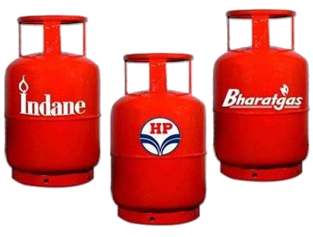

March rush problem
Most households need only 10 out 12 cylinders per year. Distributors book unconsumed subsidized cylinders to households & resell @black market
Unused- resold @market price
Subsidy leaked + tax revenue on sales of commercial cylinders also gone
Survey: give only 10 subsidized cylinders a year.

Slide 51

LPG
75 lakh households voluntarily given up their cooking gas subsidy.
If wife/husband >10 lakh taxable income in past FY, no more DBT.
Budget 2016

Slide 52
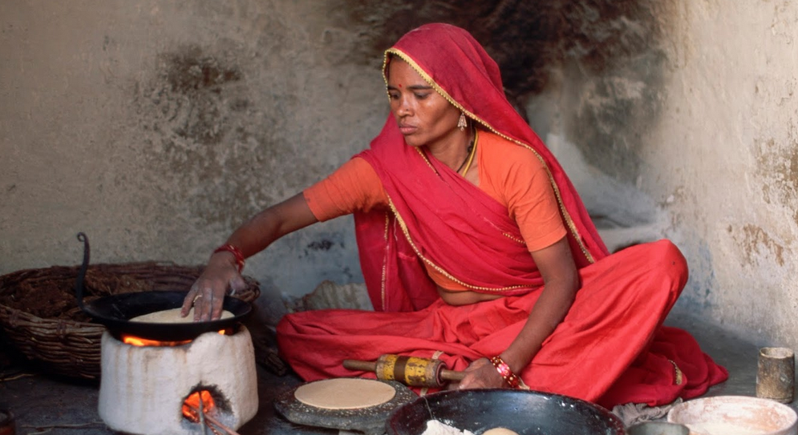
PM Ujjawala Yojana
Open-fire kitchen= drudgery, 400 cigarettes an hour
1.5 cr BPL families to get LPG connection in women's name
By Ministry of Petroleum & Nat. Gas
Rs.1600 for each LPG connection.
▲ Jobs in supply chain.
Budget 2016

Slide 53
Survey Vol.1 Ch.3: spreading jam across Indian Economy
First-mile: beneficiary identification
Middle-mile: Distribution Channel
Last-mile: Financial Inclusion
JAM-DBT good for LPG & Fertilizer
But for Food subsidy/NFSA

Slide 54


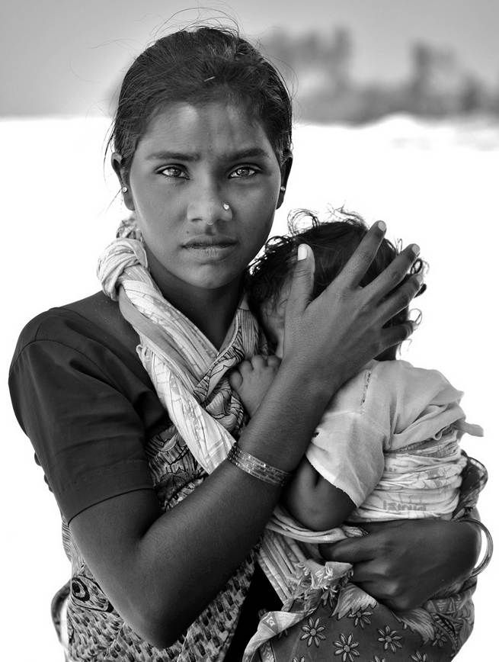

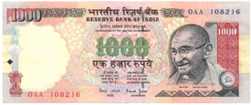
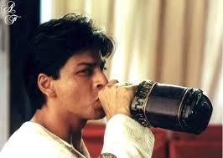
Beneficiary identification
Delivery Point
Beneficiary
Can’t jam NFSA
Per household
Per person
Per person
Rs.6,000 DBT for preg. Woman in NFSA
LPG-Beneficiary: household
delivery point:
household
Per household bank account= male member operates
Notes:
Beneficiary Identification: "ghost” / “rich” households must not benefit.
LPG universal-all households eligible. (upto 10 lakh)
What about: Farmers, pregnant women? Need database of occupation and pregnancy
Data in digital format- Doubts over SECC, only 75% junta has Adhaar

Slide 55

Coordination & Distributors’ opposition @Middle mile
Can’t jam everything
Pahal LPG
1 Petro Min
3 OMC
Kerosene
Petro Min.
State’s PDS Department
distributors
Consumer affairs- food & Public distribution
PDS-shop
Middle
Fertilizer-DBT also has minimal levels like this, hence Union should explore DBT there as well
Solution: either BAPU/ commission

Slide 56
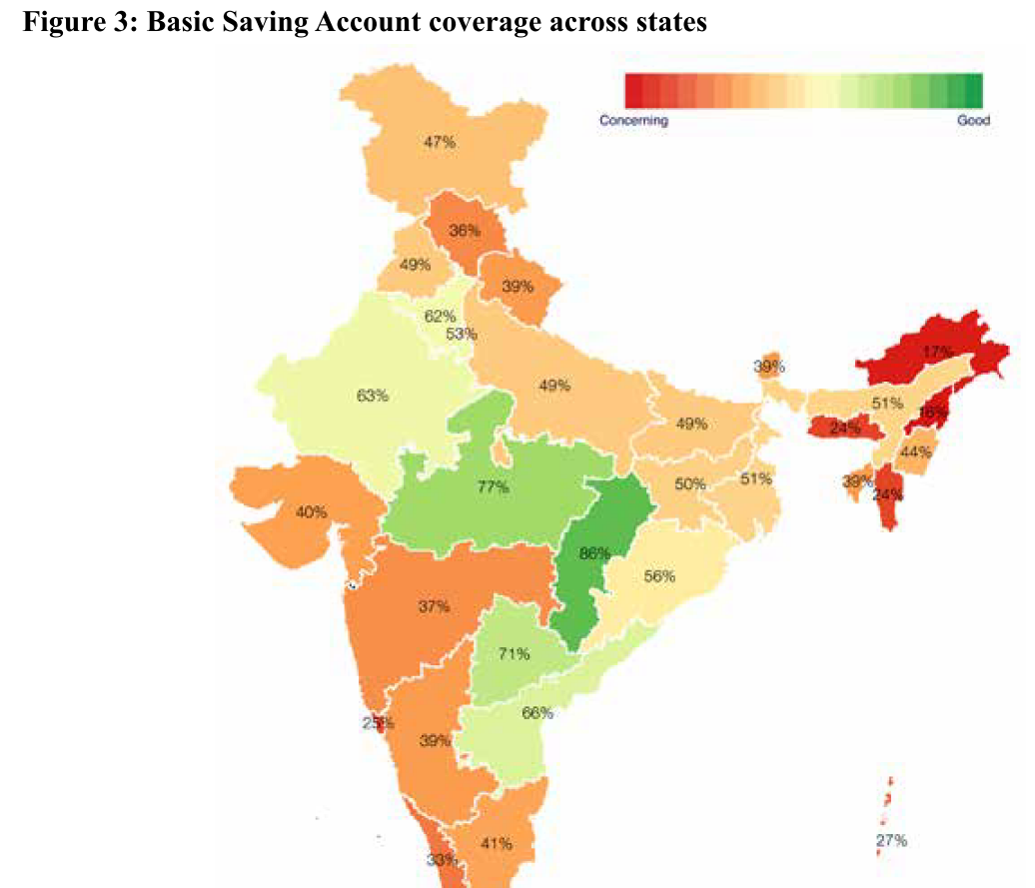
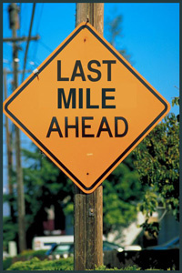
Financial inclusion @last mile
Can’t jam everything
Bank: less than 1/3rd villages have banks within 5kms
BC: 1 every 6630 people (even Kenya has better- 1:172). Should increase commission/ India Post Payment Bank?
Mobile Phone recharge=1:720- can also SMS on Ferti./food arrival; BSNL-SBI Speedpay digital wallet
All in all- lot to complete

Slide 57
O-Ring theory US-Economist Michael Kremer
All tasks of production must be executed proficiently together for any of them to be of high value.
JAM to be effective- 1st, 2nd, last mile delivery points- all have to be efficient, or binding constrain will be the minimum of the respective indicator.

Slide 58
“O” ring theory: spreading JAM across all CSS
Beneficiary identification: 30%
Distribution Channel: 20%
Financial Inclusion: 10%
Overall Efficiency / preparedness : 20% but 10%

Slide 59
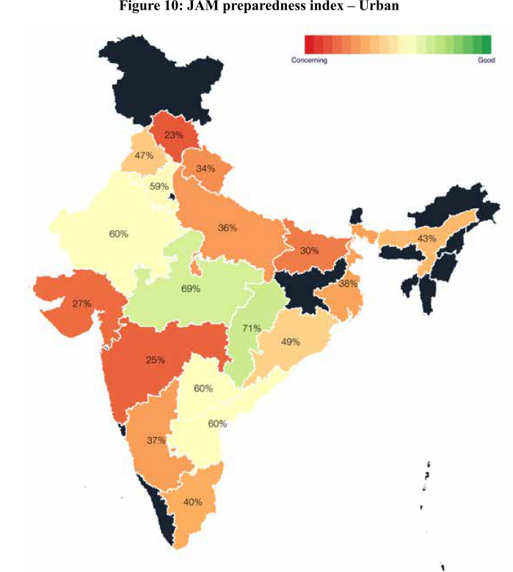


JAM / BAPU Preparedness Index
BAPU—Biometrically Authenticated Physical Uptake
Because bank penetration / BC is low so entire color “RED”- O ring theory
Thumb printout @PoS while buying subsidized product, success in Andhra Pradesh

Slide 60


LPG-JAM
Kerosene-BAPU
Food-BAPU
Fertilizer-either

Slide 61
DBT in fertilizer
minimum Government and maximum governance is to ensure targeted disbursement of Government subsidies and financial assistance to the actual beneficiaries.
Pilot DBT for fertilizer in a few districts
AFTERWARDS: Asked states to implement DBT in NFSA
Budget 2016

Slide 62


TODAY: Budget ►Revenue Part ►DEFICIT
▲Fiscal capacity, why & how?
▼Tax avoidance, evasion & litigation. How?
1 Lakh Cr. Subsidies going to rich, but We can’t JAM-DBT everything because….?

Slide 63
Revenue Part Rs.(cr.) – 2015-16
Receipt
Expenditure
Tax: 9,53,618
17,93,773
Non Tax: 4,97,629
Total:14,51,247
Deficit: 3,42,526 Cr.

Slide 64
Revenue Deficit 2015-16
Revenue Deficit: Rs. 3,42,526 Cr
2.5%
GDP 135,67,000 Cr.
@Current Price

Slide 65
Original FRBM Act’03 & 14th FC wanted RD=0 % of GDP

Slide 66
2016-17: Non-plan Expenditure (Cr.)
▼= compared to RE-2015
Non plan grants given as per
14th FC (YV Reddy)
Revenue Deficit Grant
State disaster Management
Local Bodies Grant
Interest
5L
Decreasing order
What if some of these $$ used in building capital assets?
Subsidies
2.5L (▼)
Defense
2.49L
Both Revenue + Capital
Revenue Expenditure: Salaries, stores, transport
Pension
1.2L
Grants
1.15L
Includes both Civil and defense pensioners. ▲ because OROP & 7TH PC
Police 60k

Slide 67
Revenue Deficit 2015-16
but some of the grants are used for creation of capital assets? So subtract that
Revenue Deficit: Rs. 3,42,526 Cr
Effective Revenue Deficit: Rs. 2,09,585 cr.
2.5%
1.5%
GDP 1,35,67,000 Cr.
@Current Price

Slide 68
2012: FRBM’03 Act amended to introduce ERD concept

Slide 69

FRBM Targets ERD as % of GDP
Minus grants used in capital asset creation

Slide 70

TODAY: Budget ►Revenue Part
▲Fiscal capacity, why & how?
1 Lakh Cr. Subsidies going to rich, but We can’t JAM-DBT everything because….?
▼Tax avoidance, evasion & litigation. How?

Slide 71
Pillar #2: Budget / Fiscal Policy
Fiscal Capacity
Taxation
Subsidies- can’t jam everything
Disinvestment
CSS Restr.
7th PC
GST, 14th FC
Self study

